Slide 1
ESSENTIAL
SERVICES FOR MOTOTRBO™
SYSTEMS
NORTH AMERICA REGION
XX/XX/XXXX
NAME
TITLE
Notes:
SPEAKER NOTES:

Slide 2
ENSURE CONTINUITY AND OPERATIONAL EXCELLENCE
Minimize service disruptions and unplanned downtime
Keep network devices and applications running smoothly
Ensure system components are current and compatible
Help address skill gaps and staff shortages
Gain visibility into system services and performance

Slide 3
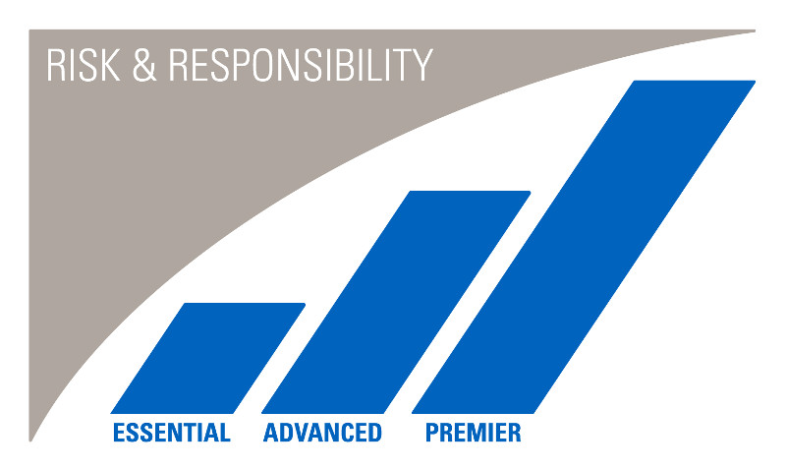
EXPERT SERVICES STRATEGY
Service packages for systems, devices and applications.
Choose the right service level that meets your operational needs.
Ensure Continuity. Enhance Productivity. Reduce Risk
Notes:
Motorola Solutions has developed a continuum of expert service to help you achieve your performance targets with the right service level you need for systems, devices and applications.
Each package provides a higher level of support to help you manage risk and responsibility.

Slide 4
ACHIEVE YOUR TARGETED OUTCOMES
ESSENTIAL SERVICES Support when you need it
Notes:
When the unpredictable happens to your network, Essential Services provide you with access to Technical Support teams and resources, the latest software updates, and hardware repair resources.

Slide 5
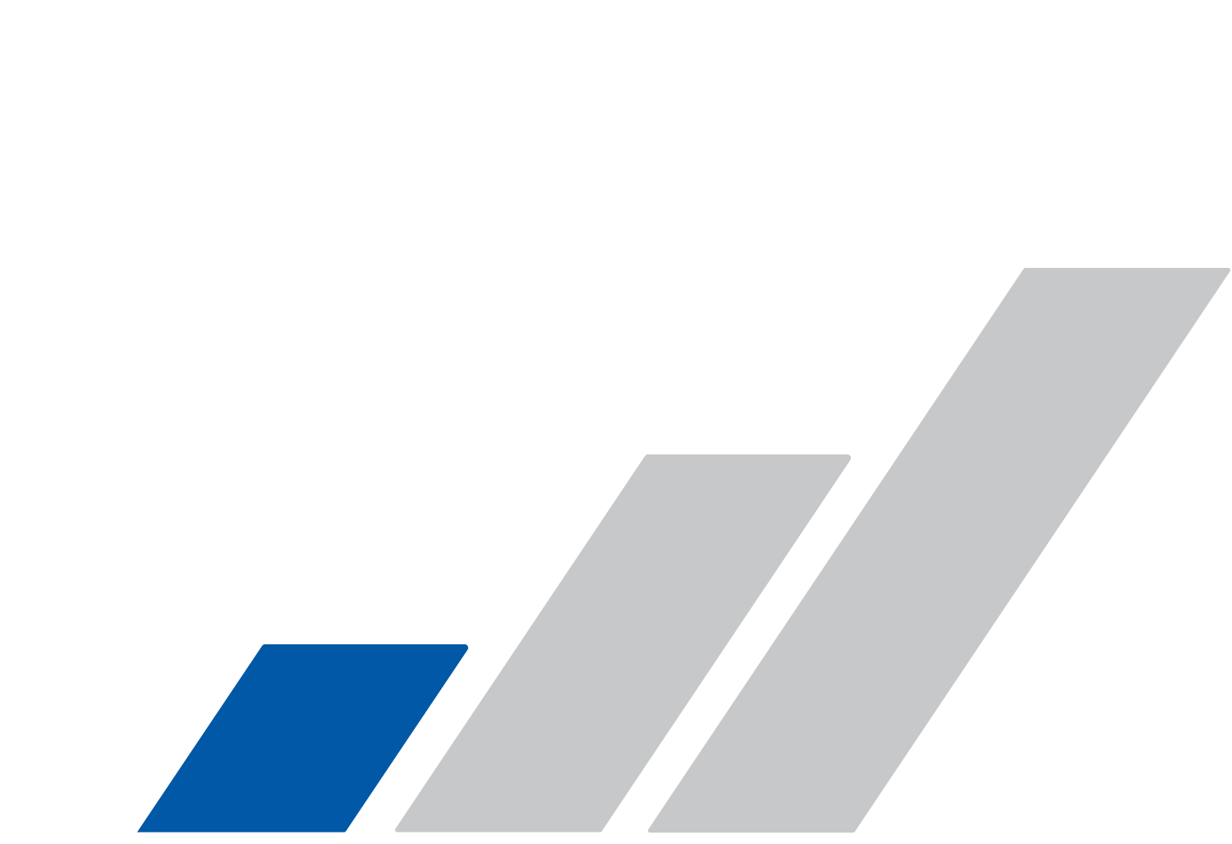
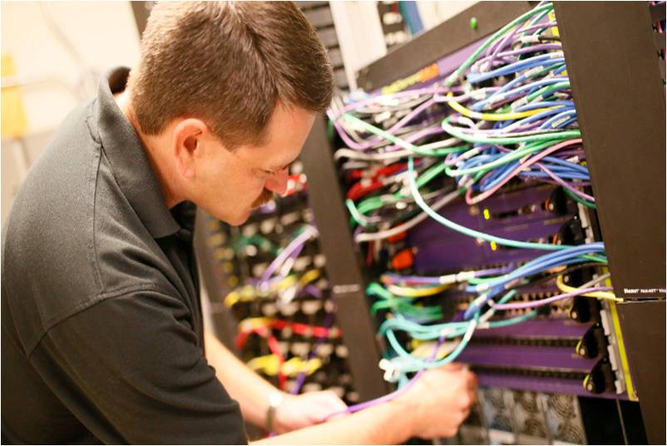
ESSENTIAL SERVICES
FOR MOTOTRBO SYSTEMS
TECHNICAL
SUPPORT
SOFTWARE UPDATES
HARDWARE REPAIR
MSI ST SUPPORT
Notes:
To help extend the useful life of your MOTOTRBO system, Essential Services offers Technical Support, Software Updates, and Hardware Repair.

Slide 6
TECHNICAL SUPPORT
ACCESS TO SYSTEM TECHNOLOGISTS WHEN YOU NEED IT
General Support: 8x5x5
Severity 1 Support: 24x7x365
Notes:
Get the help you need with one call. Our system technologists are available 8 hours a day / Monday – Friday local time, and 24x7x365 for
severity 1 cases, to help troubleshoot and resolve network issues.
You also have two days of local support—available for the duration of your contract—to use as needed for planned network activities such as: integration, programming or to optimize network operations.

Slide 7
SOFTWARE UPDATES
ENHANCED OPERATIONS
Pre-tested, certified updates to protect your network and minimize service disruptions.
Notes:
Regular software updates protect your network and enhance operations to extend the lifespan of your MOTOTRBO system. Invest in planned updates to minimize unforeseen costs and service disruptions. Software updates apply to all Motorola Solutions components within your network. All software releases are pre-tested and certified to ensure full functionality and compatibility with your network to
mitigate any impact to performance. Once validated, you can download and install when you are ready.

Slide 8
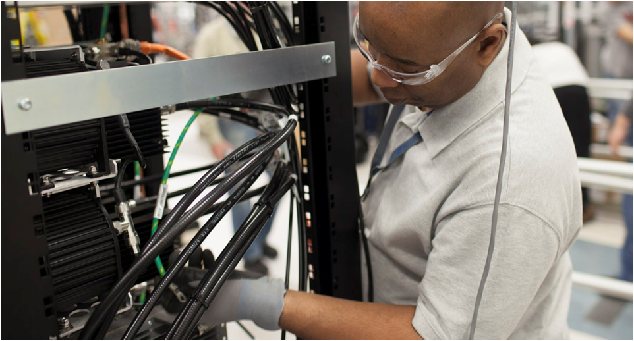
NETWORK HARDWARE REPAIR
FIXED REPAIR EXPENSE
Easily predict costs.
QUICK TURNAROUND TIME
Repairs processed quickly to keep operations running smoothly.
RELIABLE REPAIR
Sophisticated test equipment and processes for accurate repair.
Notes:
Our network hardware repair covers all Motorola Solutions manufactured equipment.
Factory trained and certified technicians troubleshoot, analyze, test and repair your equipment at our centralized facility. You will experience expert, high-quality and reliable support for rapid turnaround. Timely and accurate diagnosis and repair assures that all equipment you send to us is returned to factory specifications.

Slide 9
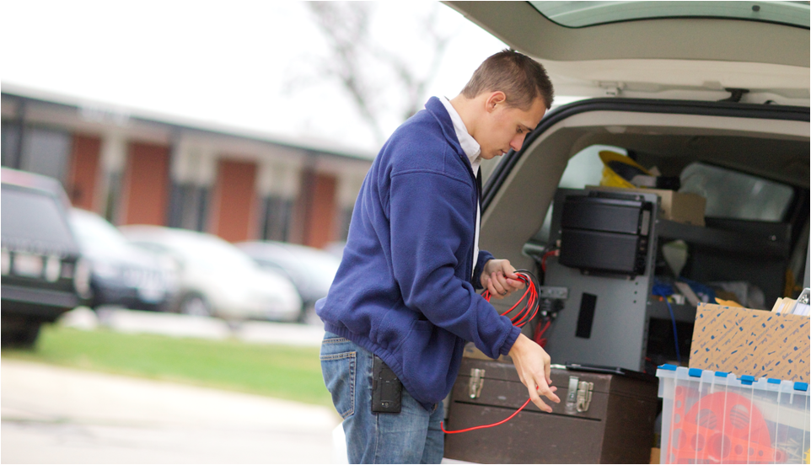
POST IMPLEMENTATION SUPPORT
ACCESS TO SYSTEM TECHNOLOGISTS
Two days of Motorola Solutions
System Technologist support—available
for the duration of your contract—to use
for post implementation needs.

Slide 10
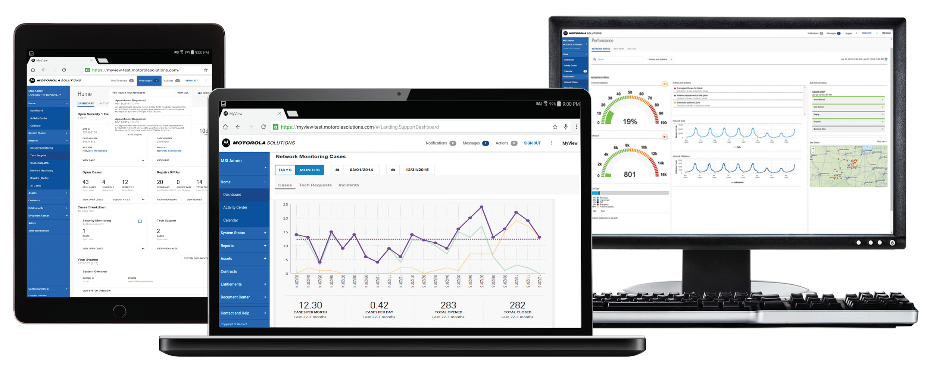
MYVIEW PORTAL FOR SERVICE VISIBILITY
Service Delivery Status
Historical Reports
Asset Information
Notes:
With your Services Package, you’ll receive access to MyView Portal, allowing you to maintain complete control and visibility of your network and the managed services you receive.
Service Delivery Status – View all open cases, repair requests, and track progress in real-time.
Historical Reports – Review critical service delivery metrics over time, such as number of closed incidents and resolution times.
Asset Information – Get quick reference to a complete view of your system’s hardware assets and equipment that is no longer supported or reaching end of support.

Slide 11
AT-A-GLANCE: ESSENTIAL SERVICES
FOR MOTOTRBO SYSTEMS
SERVICES | ESSENTIAL | ESSENTIAL PLUS
Network Hardware Repair
Self-Installed Software Updates
2 days of Motorola Solutions System Technologist support
Technical Support 8x5x5 (Severity 1 Cases 24x7x365)
Notes:
Closing wrap up.
Essential Services provide support when you need it

